Slide 1
MEAN & OMDb
Dr. Jose Annunziato

Slide 2
What is MEAN?
MEAN is a Web software stack composed of
MongoDB - a NoSQL document database
Express - a popular Node.js middle-tier library
Angular - a MVC JavaScript library
Node.js - a JavaScript runtime

Slide 3
The MEAN stack
Angular
Node.js
MongoDB
User Interface
Mongoose
Collections
Components
Schema
Data Model
Data Model
Web Client Service
Express Services

Slide 4
Download and install Node.js
Node.js is a JavaScript runtime that can be used to create middle tier applications using the JavaScript programming language
Download and install Node.js from https://nodejs.org
Verify Node.js is installed from the command line
$ node
> console.log('hello world')

Slide 5
OMDb
API
Dr. Jose Annunziato

Slide 6
Apply for an API key at omdbapi.com
Omdbapi.com is a Website that provides movie and television data accessible over an application programming interface (API)
Apply for a Web Service API Key and you will receive it as an email
Keep it safe and do not share it with others

Slide 7
Try out API
Click test link in Omdb's email confirmation, e.g., http://www.omdbapi.com/?apikey=YOURKEY&i=tt3896198
{ "Title": "Guardians of the Galaxy Vol. 2",
"Year": "2017", "Rated": "PG-13",
"Released": "05 May 2017",
"Runtime": "136 min", "Genre": "Action",
"Director": "James Gunn",
"Metascore": "67", "imdbRating": "7.8",
"imdbVotes": "322,401",
"imdbID": "tt3896198", ...
}

Slide 8
Searching for movies by keyword
http://www.omdbapi.com/?apikey=YOURKEY&s=batman
{ Search: [
{"Title": "Batman Begins",
"imdbID": "tt0372784",...},
{"Title": "Batman Returns",
"imdbID": "tt0103776", ...},
...first 10 results...
],
"totalResults": "338",
"Response": "True"
}

Slide 9
Retrieving movie details by imdbID
http://www.omdbapi.com/?apikey=YOURKEY&i=tt0372784
{ "Title": "Batman Begins",
"Year": "2005",
"Rated": "PG-13",
"Released": "15 Jun 2005",
"Director": "Christopher Nolan",
"Poster": "https://images-...",
"Ratings": [ ... ],
"Plot": "After ...",
...
}

Slide 10
ANGULAR
Dr. Jose Annunziato

Slide 11
What is Angular?
Angular is a TypeScript, open source, Web application platform
Angular is developed by the Angular Team at Google
Angular uses modern programming techniques such as OOP, strong typing, generics, inversion of control, lambdas, decorators and various design patterns

Slide 12
Install Angular CLI
Use npm to install the latest Angular CLI
Angular CLI makes it easy to create an application that already works, right out of the box
It already follows best practices!
$ npm install -g @angular/cli

Slide 13
Create an Angular Web Application
Use Angular's ng command to create a brand new Angular client application
$ ng new mean-movie-client-angular
...
Installing packages for tooling via npm.
Installed packages for tooling via npm.
Successfully initialized git.
Project 'mean-movie' successfully created.
...
$ cd mean-movie-client-angular

Slide 14
Explore the Angular Folder Structure
List the content of the new project
All your source will go in src
$ ls
.angular-cli.json
.editorconfig
.git
.gitignore
README.md
e2e
karma.conf.js
node_modules
package.json
protractor.conf.js
src
tsconfig.json
tslint.json

Slide 15
Run the Default Angular Application
The ng new command created a default, bare bones application
Run it using ng serve
Navigate to the default Web application
$ ng serve --open
** NG Live Development Server is listening on localhost:4200, open your browser on http://localhost:4200 **

Slide 16
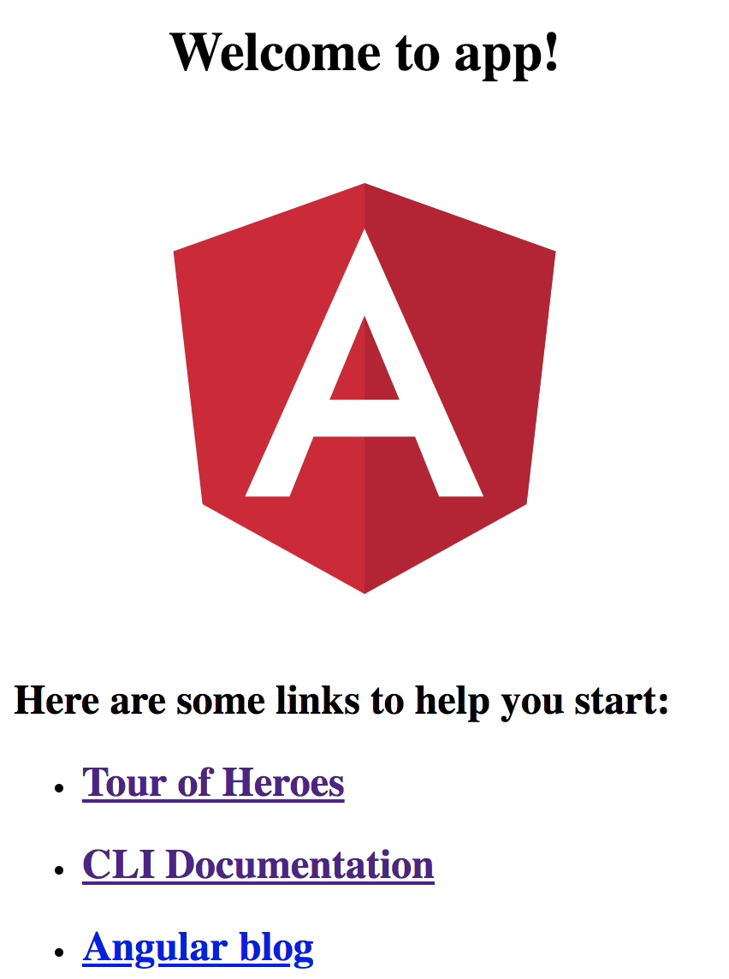
Navigate to Default Angular Application
Point your browser to http://localhost:4200
It should look similar to the image shown here

Slide 17
BOOTSTRAP & FONTAWESOME
Dr. Jose Annunziato

Slide 18
Load the bootstrap CSS Library
In src/index.html, load the latest bootstrap CSS library
<head>
<meta charset="utf-8">
<title>MeanMovie</title>
<link href="https://maxcdn.bootstrapcdn.com/bootstrap/4.0.0/css/bootstrap.min.css" rel="stylesheet"/>
</head>

Slide 19
Load the fontawesome Font Library
In src/index.html, load the latest fontawesome font library
<head>
<meta charset="utf-8">
<title>MeanMovie</title>
<link href="https://maxcdn.bootstrapcdn.com/font-awesome/4.7.0/css/font-awesome.min.css" rel="stylesheet"/>
</head>

Slide 20
Alternatively, Install Bootstrap
Instead of linking libraries, you can install them
$ npm install bootstrap --save $ npm install font-awesome --save
And then move the files to src/assets
$ mv node_modules/bootstrap/dist src/assets $ mv node_modules/font-awesome/css src/assets $ mv node_modules/font-awesome/fonts src/assets

Slide 21
Link the files in index.html
Then link to new local files
<link href="assets/dist/css/bootstrap.min.css" rel="stylesheet"/>
<link href="assets/css/font-awesome.min.css" rel="stylesheet"/>
Now IDE can perform auto complete

Slide 22
MOVIE MODEL
Dr. Jose Annunziato

Slide 23
Create an Angular Movie Model
In src/models/movie.model.client.ts, create an Angular movie model to hold movie data
export class Movie {
Title: string;
Plot: string;
imdbID: string;
Poster: string;
}
case based on Omdb's movie schema. Omdb uses uppercase

Slide 24
MOVIE SERVICE
Dr. Jose Annunziato

Slide 25
Create an Angular Service Client
In src/services/omdb.service.client.ts, create an angular movie service client to retrieve movies from omdb.com
export class OmdbServiceClient {
url = 'http://omdbapi.com?apikey=YOURKEY&'
findMoviesByKeyword = keyword =>...
findMovieByImdbId = imdbId =>...
}

Slide 26
Make Services Injectable
Angular uses dependency injection to reuse resources throughout an application
Decorate the service as Injectable to reuse elsewhere
import {Injectable} from '@angular/core';
@Injectable()
export class OmdbMovieService {...}

Slide 27
Implement findMoviesByKeyword()
Implement findMoviesByKeyword()
findMoviesByKeyword
= keyword =>
fetch(this.url +
's=' + keyword)
.then(res => res.json())

Slide 28
Implement findMovieByImdbId()
Implement findMovieByImdbId()
findMoviesByImdbId
= imdbId =>
fetch(this.url +
'i=' + imdbId)
.then(res => res.json())

Slide 29
Register Movie Service
Register services in src/app/app.module.ts
import { OmdbMovieService }
from '../services/movie.service.client';
...
@NgModule({
...
providers: [ OmdbMovieService ]
})
export class AppModule { }

Slide 30
SEARCH COMPONENT
Dr. Jose Annunziato

Slide 31
Create a Movie Search Component
Create src/components directory
Use ng g c command to generate an Angular movie-search component
Verify the component is in src/movie-search
$ ng g c movie-search

Slide 32
Explore the Angular Component
An Angular component consists of 4 files as shown below
Implement data and control logic in the *.ts file
Implement unit tests in the *.spec.ts file
movie-search.component.css
movie-search.component.html
movie-search.component.spec.ts
movie-search.component.ts
components are composed of CSS, HTML, and TS files

Slide 33
SEARCH INTERFACE
Dr. Jose Annunziato

Slide 34
Explore the Angular Component
In movie-search.component.html, add a form
<h1>Search Movies</h1>
<div class="input-group">
<input class="form-control">
<div class="input-group-append">
<button class="btn btn-primary">
Search
</button>
</div>
</div>
classes and layout are based on bootstrap 4.0 styling

Slide 35
Display the Movie Search Component
In app.component.html, replace the default content to render the new movie search component
Wrap the component with a bootstrap fluid container to add some padding all around
<div class="container-fluid">
<app-movie-search>
</app-movie-search>
</div>

Slide 36
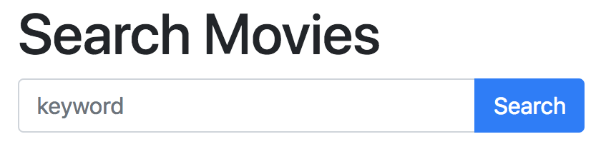
Navigate to Movie Search Component
Navigate to the movie search component http://localhost:4200/
Verify it renders as shown here

Slide 37
Add FormModule
In app-module.ts, import FormModule
import {FormsModule} from '@angular/forms';
@NgModule({
imports: [
...
FormsModule
],
})
export class AppModule { }

Slide 38
Tie View to Controller
In movie-search.component.html...
<h1>Search Movies</h1>
<div class="input-group">
<input [(ngModel)]="keyword"
class="form-control">
<div class="input-group-append">
<button (click)="search()">
Search
</button>
</div>

Slide 39
SEARCH CONTROLLER
Dr. Jose Annunziato

Slide 40
Tie Controller to View
In movie-search.component.ts declare the variable and event handlers bound to the view
export class MovieSearchComponent... {
keyword: string;
search = () => { }
}

Slide 41
Implement Component Data and Logic
In movie-search.ts, import the movie model
We'll bind the search results to the movies variable
import { Movie } from
'../../models/movie.model.client';
export class MovieSearchComponent ...
movies: Movie[];
}

Slide 42
Inject the Movie Service
In movie-search.ts, inject the movie service
import { OmdbMovieService } from
'../../services/movie.service.client';
...
export class MovieSearchComponent ...
constructor(
private service: OmdbMovieService){}
}

Slide 43
Use Movie Service from Event Handler
In movie-search.ts, use the movie service to search for a movie when the user clicks on search
search() {
this.service
.findMoviesByKeyword(this.keyword)
.then(response =>
this.movies = response.Search)
}

Slide 44
Render the Search Result
In movie-search.html, render movies as a list
<h2>Search Results</h2>
<ul class="list-group">
<li *ngFor="let m of movies"
class="list-group-item">
{{m.Title}}
</li>
</ul>

Slide 45
Add a Poster Image
In movie-search.html, add a poster image
<li *ngFor="let m of movies"
class="list-group-item">
<img src="{{m.Poster}}"
width="30px">
{{m.Title}}
</li>

Slide 46
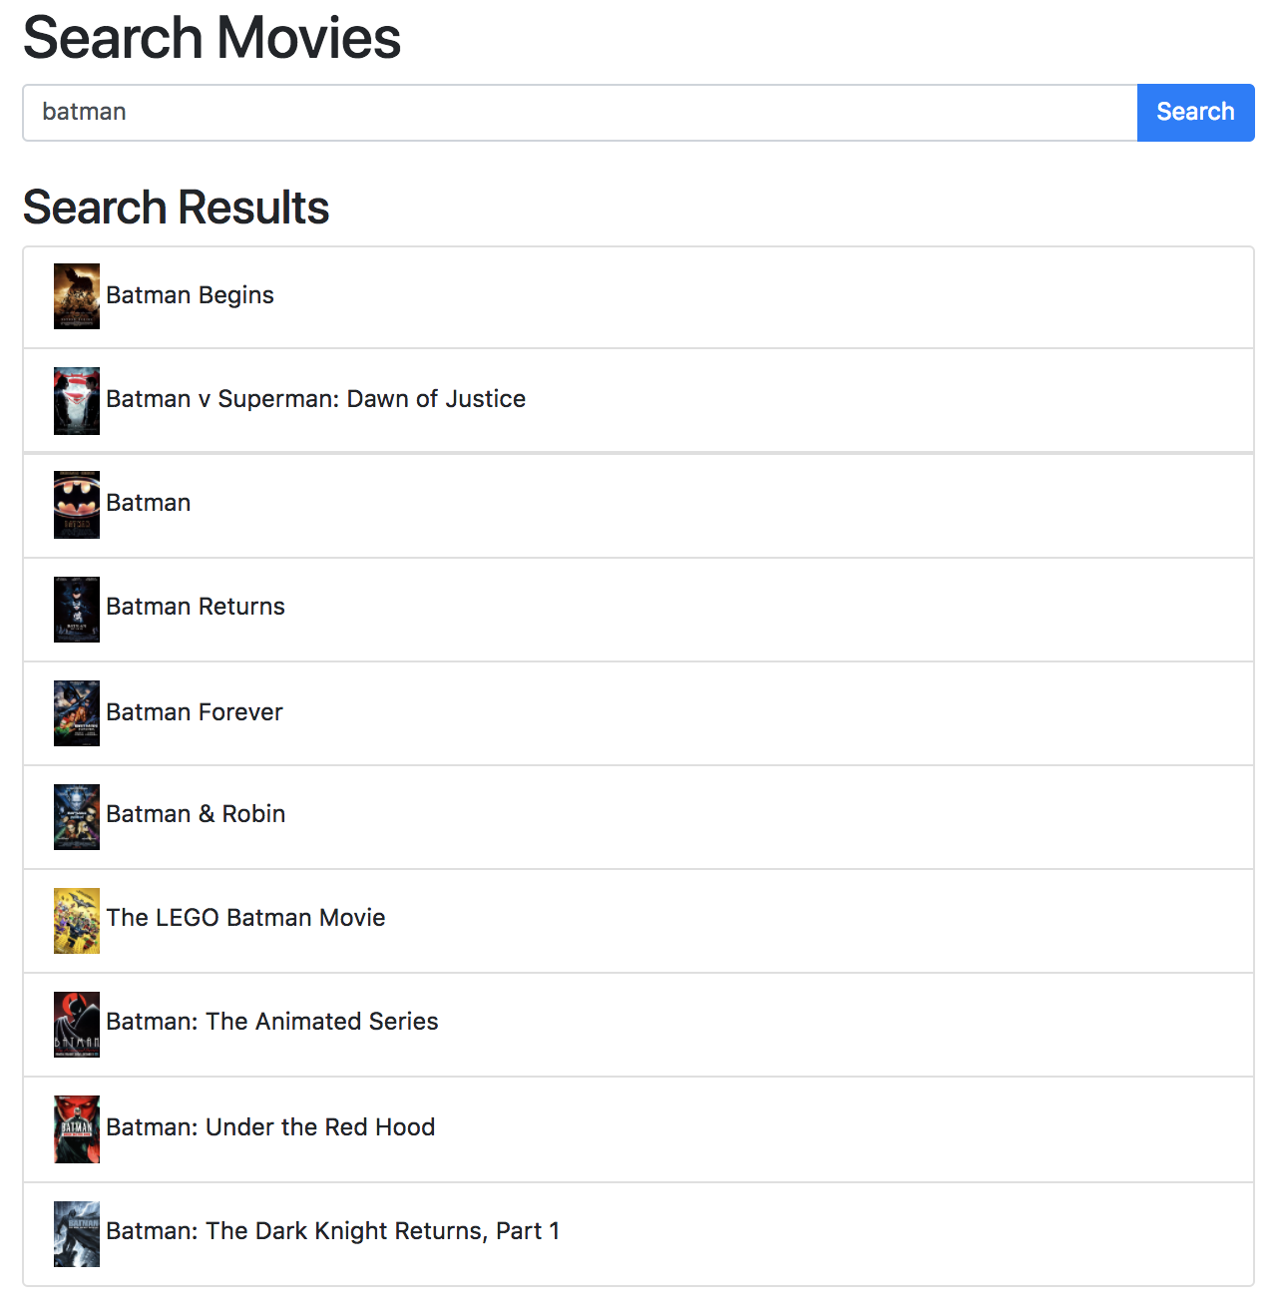
Search for a Movie
Search for batman and verify results render as shown here

Slide 47
MOVIE DETAILS
Dr. Jose Annunziato

Slide 48
Add a Movie Details Event Handler
In movie-search.html, add movie event handler
<li (click)="details(m.imdbID)"
*ngFor="let m of movies"
class="list-group-item">
<img src="{{m.Poster}}"
width="30px">
{{m.Title}}
</li>

Slide 49
Implement Movie Details Event Handler
In movie-search.ts, implement detail handler
movie: Movie;
details = imdbID =>
this.movieService
.findMovieByImdbId(imdbID)
.then(response =>
this.movie = response)

Slide 50
Highlight Selected Movie
<li (click)="details(m.imdbID)"
*ngFor="let m of movies"
[ngClass]="{'active':
m.imdbID === movie.imdbID}"
class="list-group-item">
<img src="{{m.Poster}}"
width="30px">
{{m.Title}}
</li>

Slide 51
Add a Movie Details Column
In movie-search.html, add details column
<div class="row">
<div class="col-md-6">
<h1>Search Movies</h1>
...
</div>
<div class="col-md-6">
<h1>{{movie.Title}}</h1>
</div>
</div>

Slide 52
Render the Following Movie Details
In movie-search.html, render following details:
<h1>{{movie.Title}}</h1>
<div class="row">
<div class="col-md-4">
<img width="100%" src="{{movie.Poster}}"/>
</div>
<div class="col-md-8">
<p>{{movie.Plot}}</p>
</div>
</div>

Slide 53
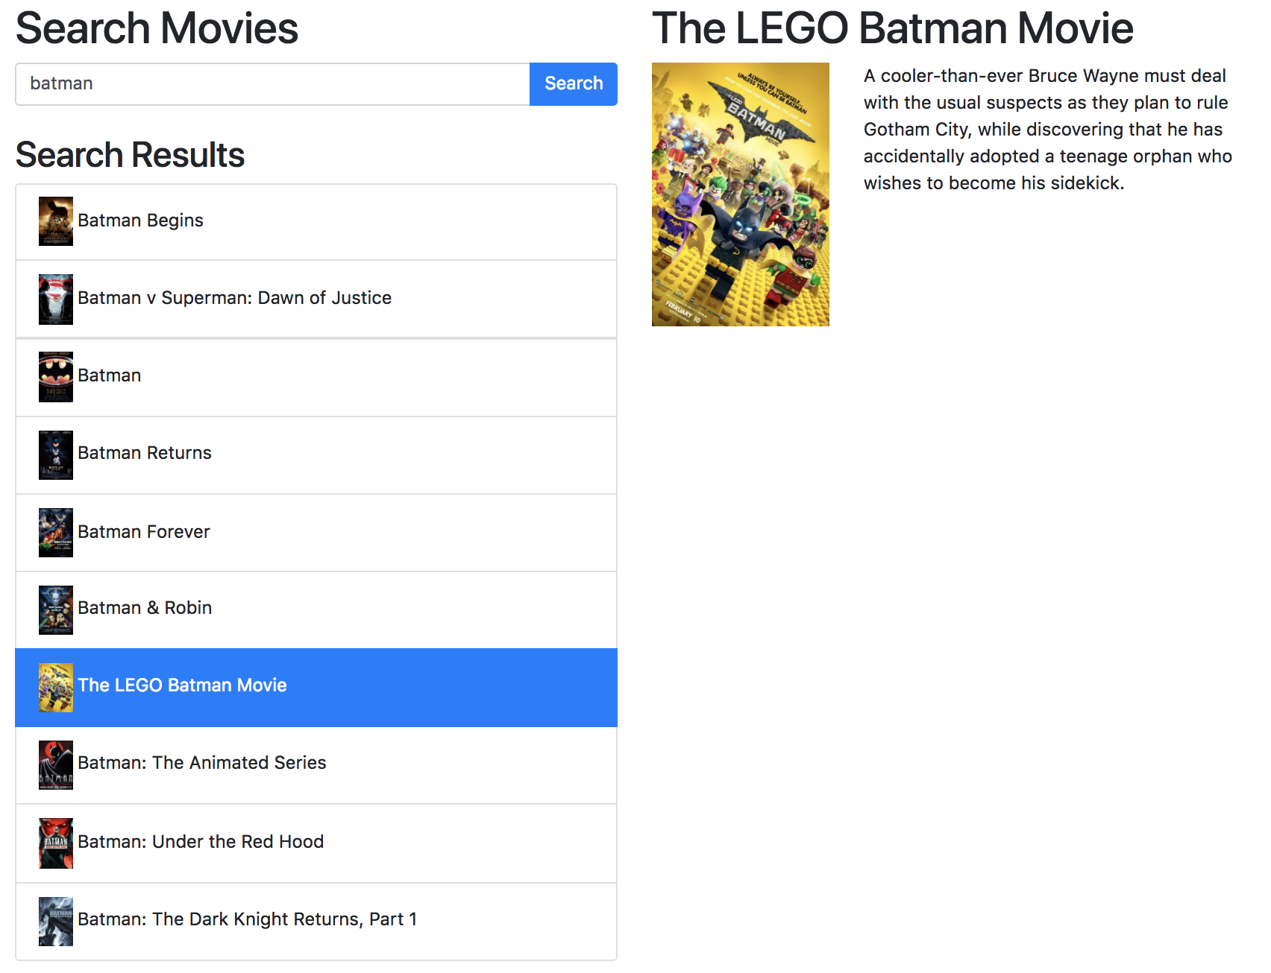
Search and Select a Movie for Details

Slide 54
LIKE A MOVIE
Dr. Jose Annunziato

Slide 55
Add Like/Unlike Icons Next to Movies
In movie-search.html, add stars to like/unlike
<h2>Search Results</h2>
<ul class="list-group">
<li ... class="list-group-item">
<img src="{{m.Poster}}" width="30px">
{{m.Title}}
<i (click)="like(m, false)"
class="fa fa-star float-right"></i>
<i (click)="like(m, true)"
class="fa fa-star-o float-right"></i>
</li>
</ul>

Slide 56
Implement Like/Unlike
In movie-search.ts, implement like/unlike
liked: Movie[] = [];
like = (movie, likedMovie) => {
const index = this.liked.indexOf(movie);
if (index === -1 && likedMovie) {
this.liked.push(movie);
} else if (index !== -1 && !likedMovie) {
this.liked.splice(index, 1);
}
}

Slide 57
Add a Like/Unlike Column
In movie-search.html, add a new column
<div class="row">
<div class="col-md-6col-md-4">
<h1>Search Movies</h1>
</div>
<div class="col-md-6col-md-4">
<h1>{{movie.Title}}</h1>
</div>
<div class="col-md-4">
<h2>Liked</h2>
</div>
</div>

Slide 58
Render Liked Movies in New Column
<div class="col-md-4"> <h1>Liked</h1>
<ul class="list-group">
<li (click)="details(m.imdbID)"
*ngFor="let m of liked" class="list-group-item"
[ngClass]="{'active': m.imdbID===movie.imdbID}">
<img src="{{m.Poster}}" width="30px">{{m.Title}}
<i (click)="like(m, false)"
class="fa fa-star float-right"></i>
<i (click)="like(m, true)"
class="fa fa-star-o float-right"></i>
</li>
</ul>
</div>

Slide 59
Paint Liked Stars as Yellow
In movie-search.html, add text-warning class to full star to paint it yellow
<i (click)="like(m, false)"
class="fa fa-star float-right
text-warning">
</i>

Slide 60
Make Stars and Empty Stars Exclusive
Use hidden to hide stars and empty stars mutually exclusive
<i (click)="like(m, false)"
[hidden]="liked.indexOf(m) === -1"
class="fa fa-star float-right
text-warning"></i>
<i (click)="like(m, true)"
[hidden]="liked.indexOf(m) > -1"
class="fa fa-star-o float-right"></i>

Slide 61
NODE.JS
EXPRESS
Dr. Jose Annunziato

Slide 62
Node.js
Node.js is an open-source, cross-platform JavaScript run-time environment that executes JavaScript code outside of a browser
Download Node.js from https://nodejs.org/
Execute JavaScript from command line:
$ node hello.js

Slide 63
Create a Node.js Movie Server App
Choose a directory where to implement a Node.js server application, e.g., mean-movie-server-node
Accept the default configurations
$ mkdir mean-movie-server-node
$ cd mean-movie-server-node
$ npm init

Slide 64
Install Express and Mongoose Modules
Express is a Node.js library module for creating middle tier HTTP Web service endpoints
Mongoose is a Node.js library module that allows interacting with MongoDB
$ npm install mongoose --save
$ npm install express --save

Slide 65
MONGO
Dr. Jose Annunziato

Slide 66
Download and MongoDB
MongoDB is a NoSQL document based database
Read all about MongoDB at https://www.mongodb.com/
Download and install the free community version at https://goo.gl/zFsgLZ
My slides on MongoDB cover the topic in detail https://goo.gl/YdssiL

Slide 67
Use mongod to Start Database Server
From the command line, use mongod to start the database server
On macOS, you might need to use sudo
> sudo mongod

Slide 68
Use mongo to Connect to Database
From the command line, use mongo to connect to the database server
> mongo
MongoDB shell version v3.4.7
connecting to: mongodb://127.0.0.1:27017
MongoDB server version: 3.4.7
...
>

Slide 69
Create a movie database
Create a database using the use command
All subsequent commands will be relative to the current database in use
> use mean-movie
switched to db mean-movie
>

Slide 70
Inserting a Movie
Use the insert() command to insert data into a collection. Data is formatted as JSON objects
Inserting movie object into movie collection
Inserting data creates collection if none existent
> db.movie.insert({
Title: 'Avatar',
Plot: 'A paraplegic marine ...',
imdbID: 'tt0499549'});

Slide 71
Inserting Several Movies
db.movie.insert({
Title: 'Titanic', imdbID: 'tt0120338',
Plot: 'A seventeen-year-old aristocrat...',
});
db.movie.insert({
Title: 'Aliens', imdbID: 'tt0090605',
Plot: 'Ellen Ripley is rescued...',
});
db.movie.insert({
Title: 'The Terminator', imdbID: 'tt0088247',
Plot: 'A seemingly indestructible humanoid',
});

Slide 72
Querying documents
> db.movie.find().pretty()
{ "_id" : ObjectId("5ab107c757176cb3d63a..."),
"Title" : "Avatar",
"Plot" : "A paraplegic marine ...",
"imdbID" : "tt0499549"
}
{ "_id" : ObjectId("5ab107cf57176cb3d63a..."),
"Title" : "Titanic",
"imdbID" : "tt0120338",
"Plot" : "A seventeen-year-old aristocra..."
}...

Slide 73
MONGOOSE MODELS
Dr. Jose Annunziato

Slide 74
Download and install Mongoose
Mongoose is a Node.js MongoDB driver
It provides abstractions such as schemas, validation, and collection references
Read all about mongoose at http://mongoosejs.com/
Use npm to install mongoose
$ npm install mongoose --save

Slide 75
Connect to the database
In src/app/models/db.js, connect to the movie database
module.exports = function() {
var mongoose = require('mongoose'); mongoose.connect
('mongodb://localhost/mean-movie');
}

Slide 76
Create a server movie schema
In src/app/models/movie.schema.server.js, create the following movie schema:
var mongoose = require('mongoose');
var movieSchema = mongoose.Schema({
Title: String, Plot: String,
Poster: String, imdbID: String,
liked: Boolean
}, {collection: 'movies');
module.exports = movieSchema;

Slide 77
Create a server movie model
In src/app/models/movie.model.server.js, create the following movie model:
var mongoose = require('mongoose');
var movieSchema =
require('./movie.schema.server');
var movieModel =
mongoose.model('Movie',
movieSchema);
module.exports = movieModel;

Slide 78
Implement findMovieById()
In src/app/models/movie.model.server.js, implement findMovieById()
movieModel.findMovieById = (id) =>
return movieModel.findById(id);

Slide 79
Implement createMovie()
In src/app/models/movie.model.server.js, implement createMovie()
movieModel.createMovie = (movie) =>
movieModel.create(movie)

Slide 80
Implement updateMovie()
In src/app/models/movie.model.server.js, implement updateMovie()
movieModel.updateMovie = (movie) =>
movieModel.update(
{_id: movie._id},
{$set: movie});

Slide 81
Implement likeMovie()
movieModel.likeMovie = (movie, liked) => {
movie.liked = liked;
return findMovieById(movie._id)
.then(function (_movie) {
if(!_movie) {
return createMovie(movie)
} else {
return updateMovie(movie);
}});}

Slide 82
REST SERVICE
Dr. Jose Annunziato

Slide 83
Implement a Simple Express Server
In server.js, create an express HTTP server
var express = require('express');
app = express();
app.get('/', function(req, res){
res.send('hello world');
});
app.listen(3000);

Slide 84
Enable CORS on Server
app.use(function(req, res, next) {
res.header("Access-Control-Allow-Origin", "*");
res.header("Access-Control-Allow-Headers",
"Origin, X-Requested-With, Content-Type, Accept");
res.header("Access-Control-Allow-Methods",
"GET, POST, PUT, DELETE, OPTIONS");
next();
});

